Slide 1

The 23rd Annual
Popsicle Stick Bridge Competition
2010 High School Winners Gallery

Slide 2
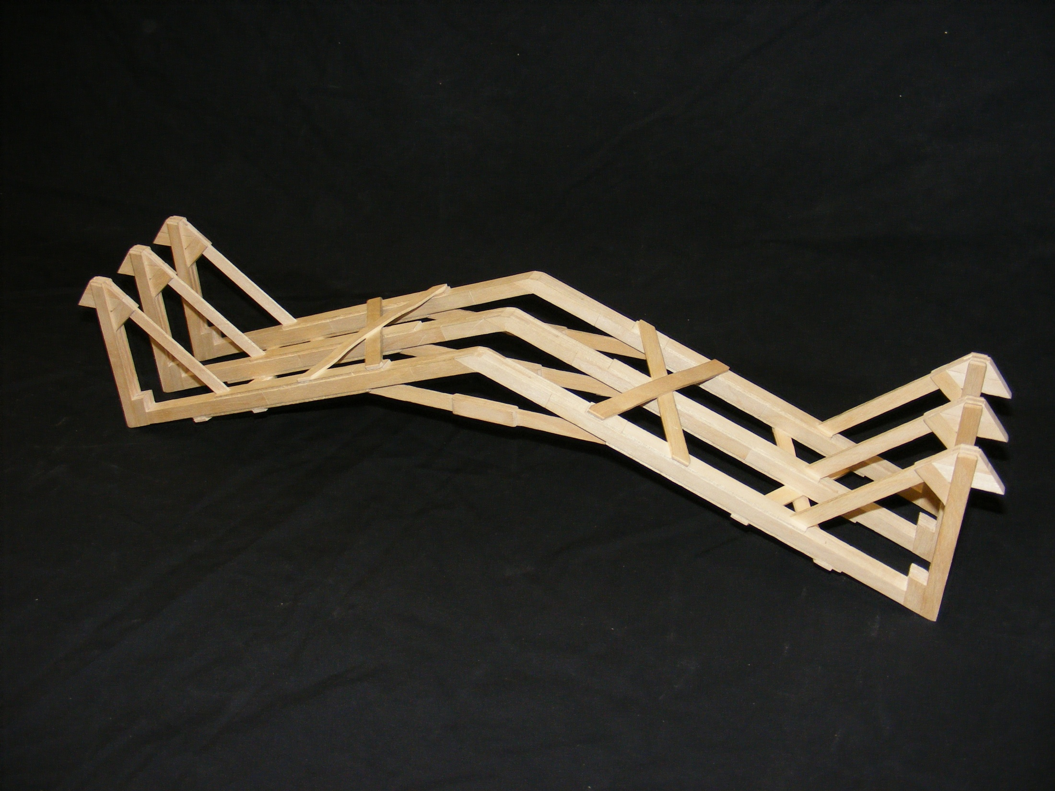
The 23rd Annual
Popsicle Stick Bridge Competition
Nicole Weisensee
Highland Secondary
1st Place Overall and Best Senior Workmanship
Bridge Weight = 189.3g
Performance Rating = 3706.5 lb/lb

Slide 3
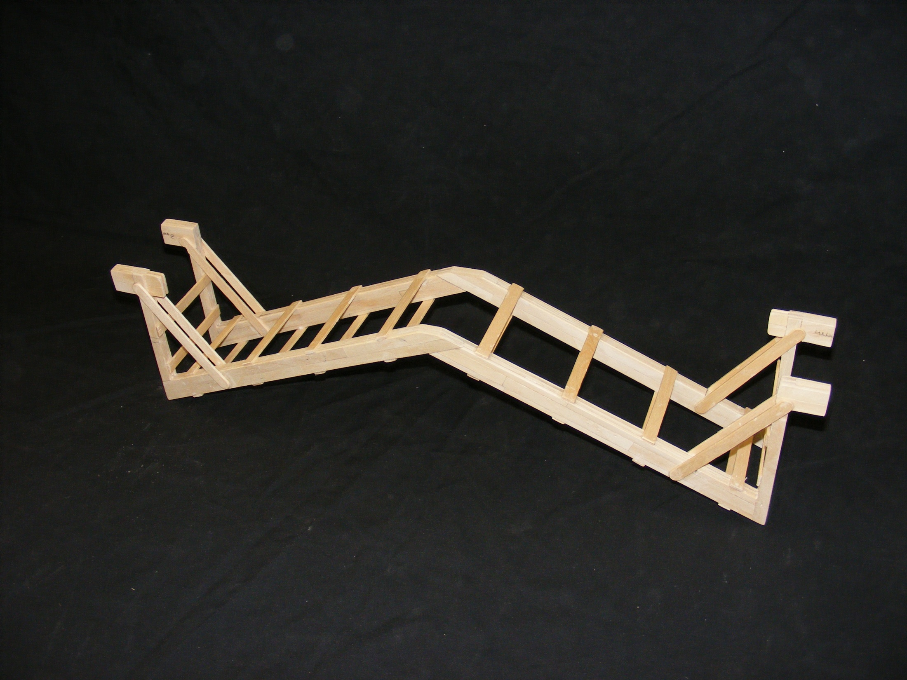
The 23rd Annual
Popsicle Stick Bridge Competition
Aleksander Tepsic and Stefan Misevski
Orchard Park
2nd Place Overall
Bridge Weight = 225.1g
Performance Rating = 3040.8 lb/lb

Slide 4
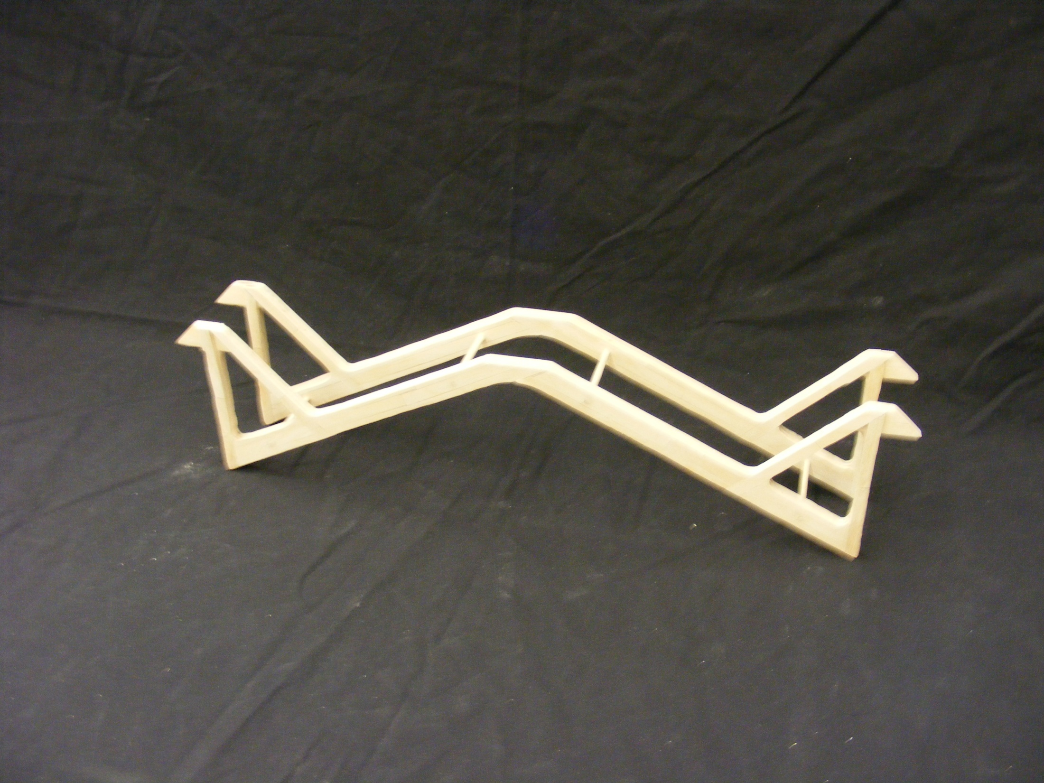
The 23rd Annual
Popsicle Stick Bridge Competition
Alex Gloin
Westmount Secondary
3rd Place Overall
Bridge Weight = 230.2g
Performance Rating = 3023.9 lb/lb

Slide 5
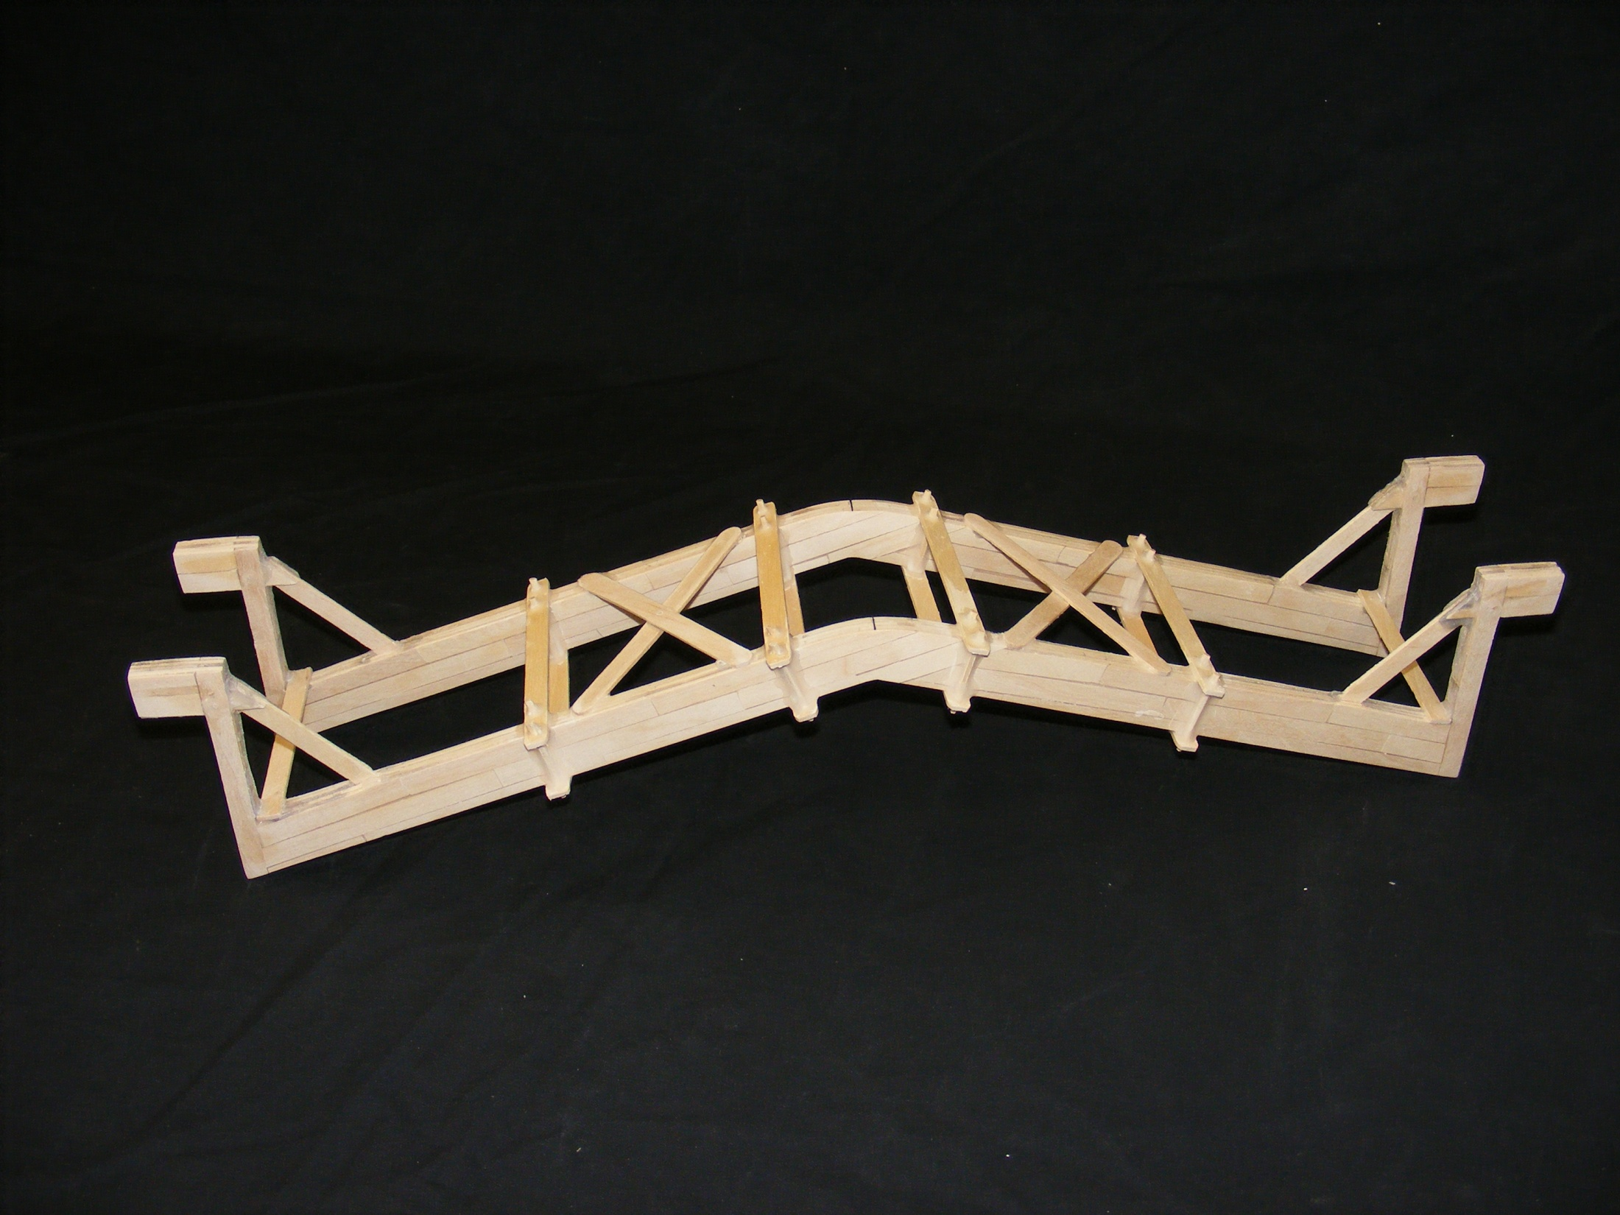
The 23rd Annual
Popsicle Stick Bridge Competition
Brett Hand
EC Drury
4th Place Overall
Bridge Weight = 241.8g
Performance Rating = 2769.7 lb/lb

Slide 6
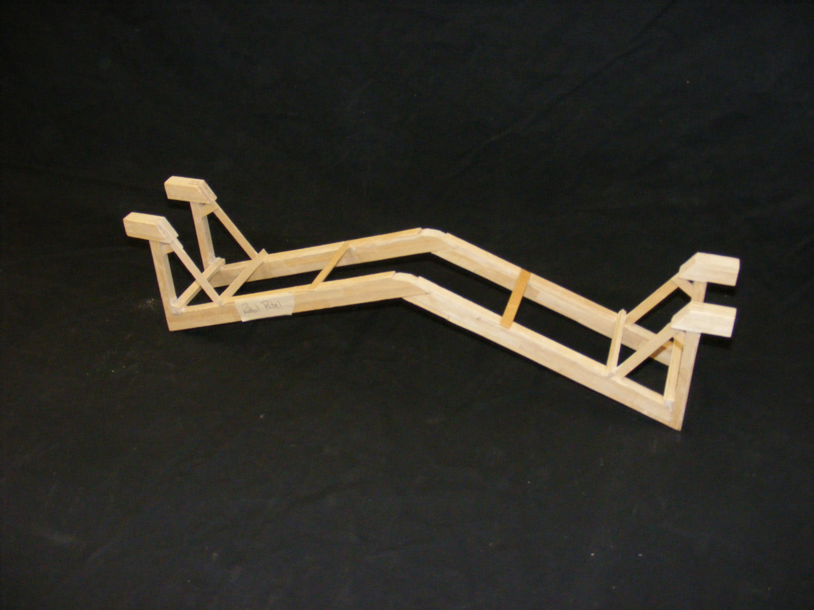
The 23rd Annual
Popsicle Stick Bridge Competition
Rahul Patel
Orchard Park
5th Place Overall
Bridge Weight = 229.6g
Performance Rating = 2115.1 lb/lb

Slide 7
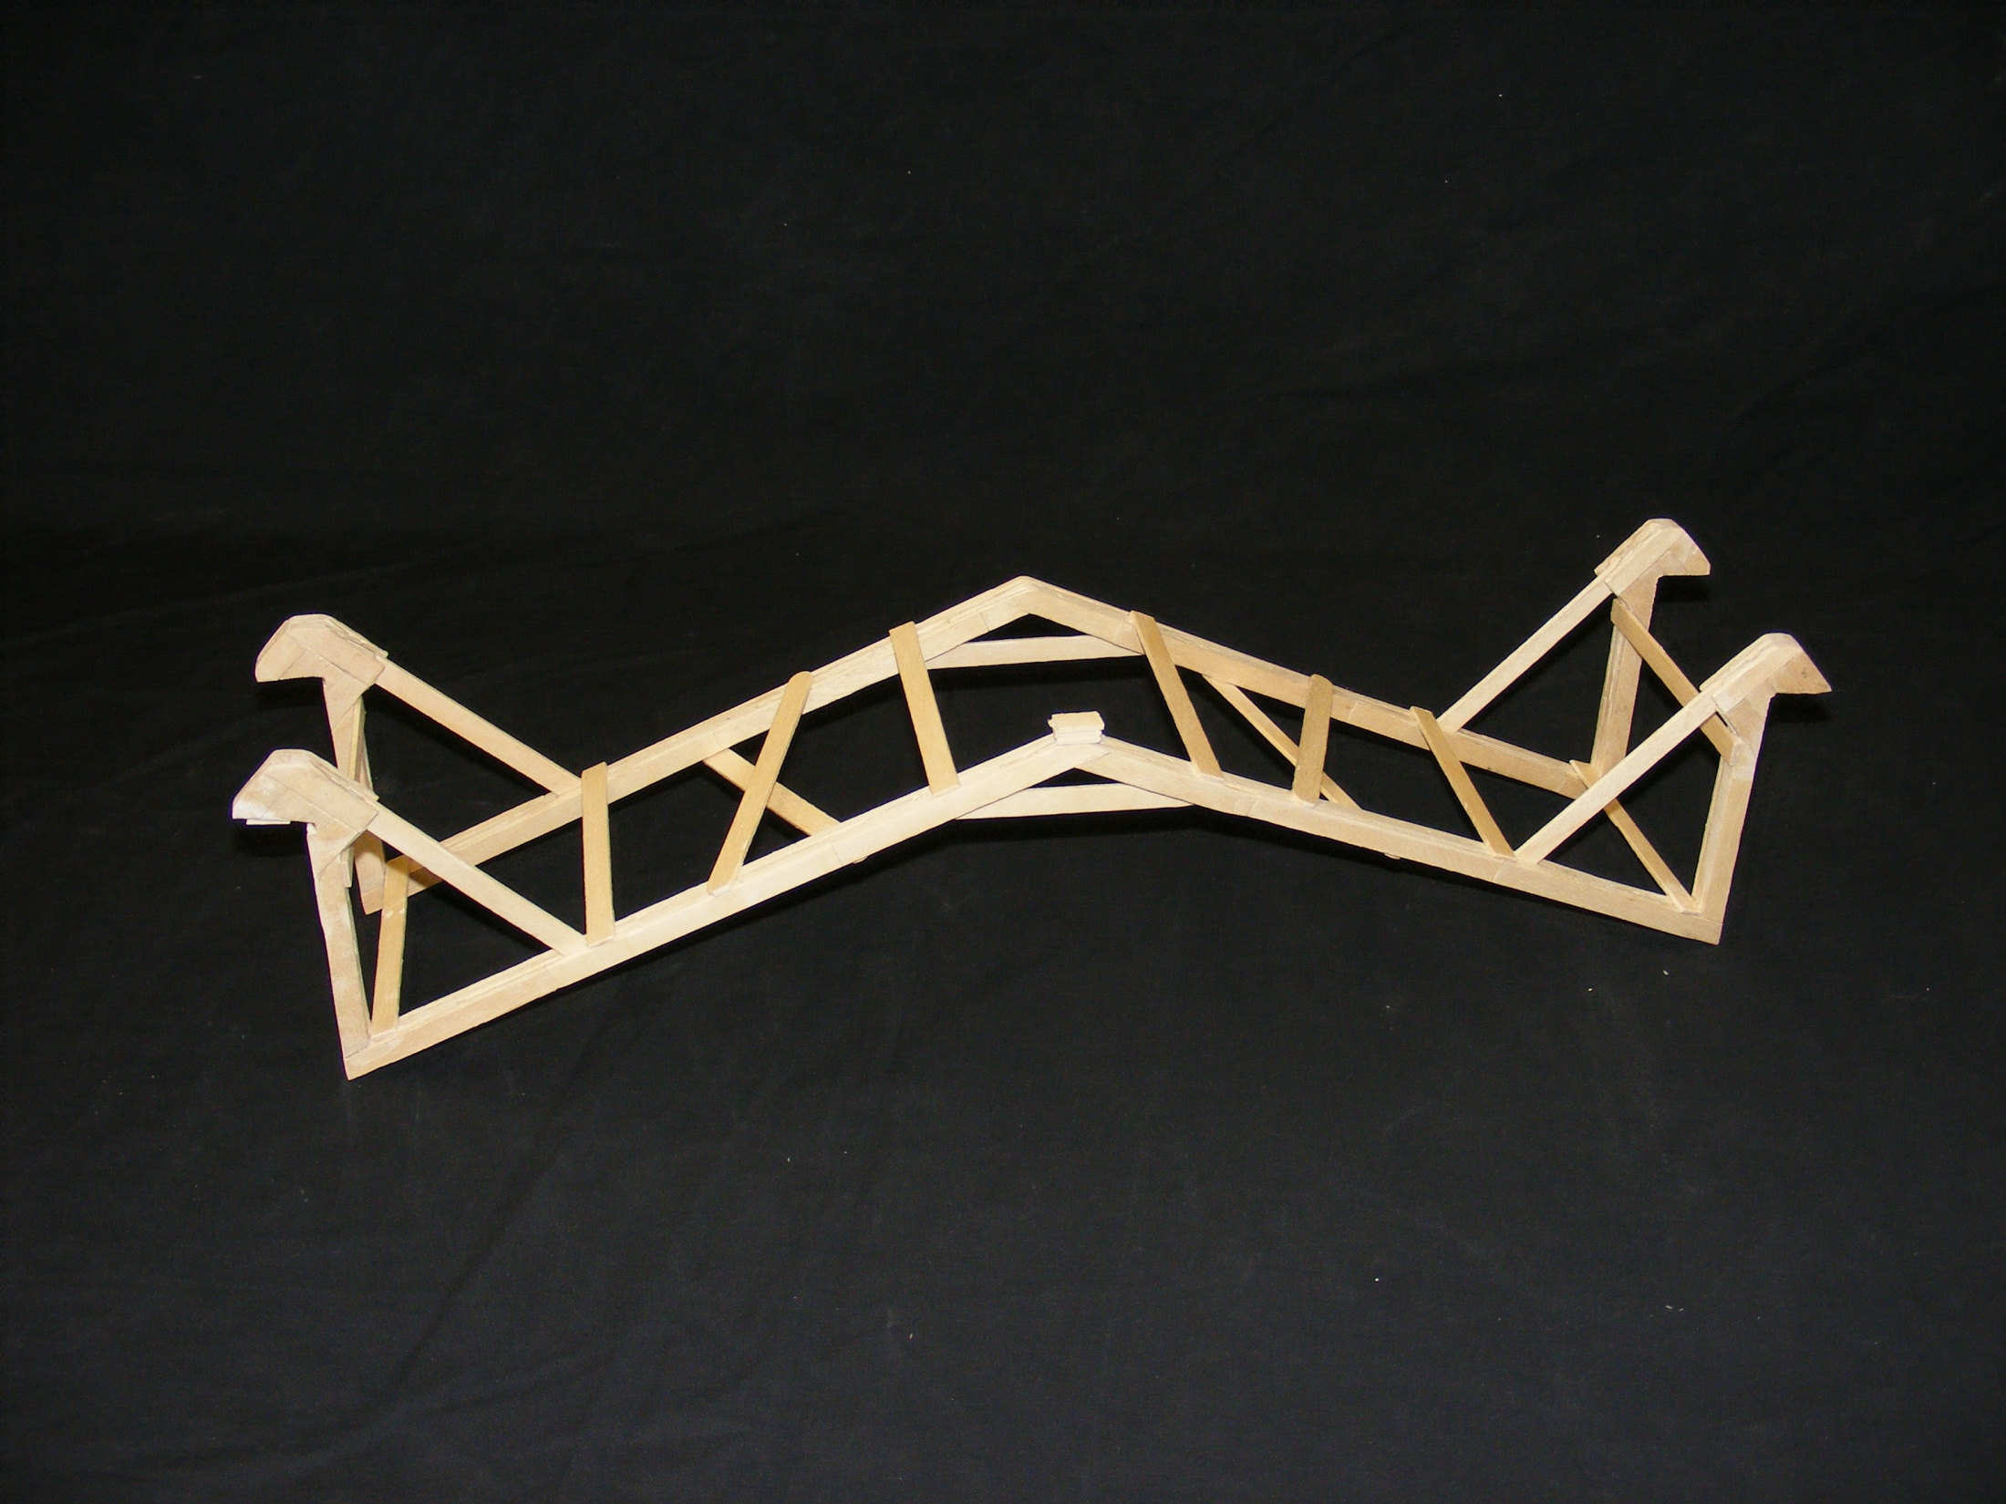
The 23rd Annual
Popsicle Stick Bridge Competition
Alyssa Bruulsema
Hamilton District Christian High
Best Overall Junior and
Best Junior Workmanship
Bridge Weight = 133.4g
Performance Rating = 1564.5 lb/lb

Slide 8
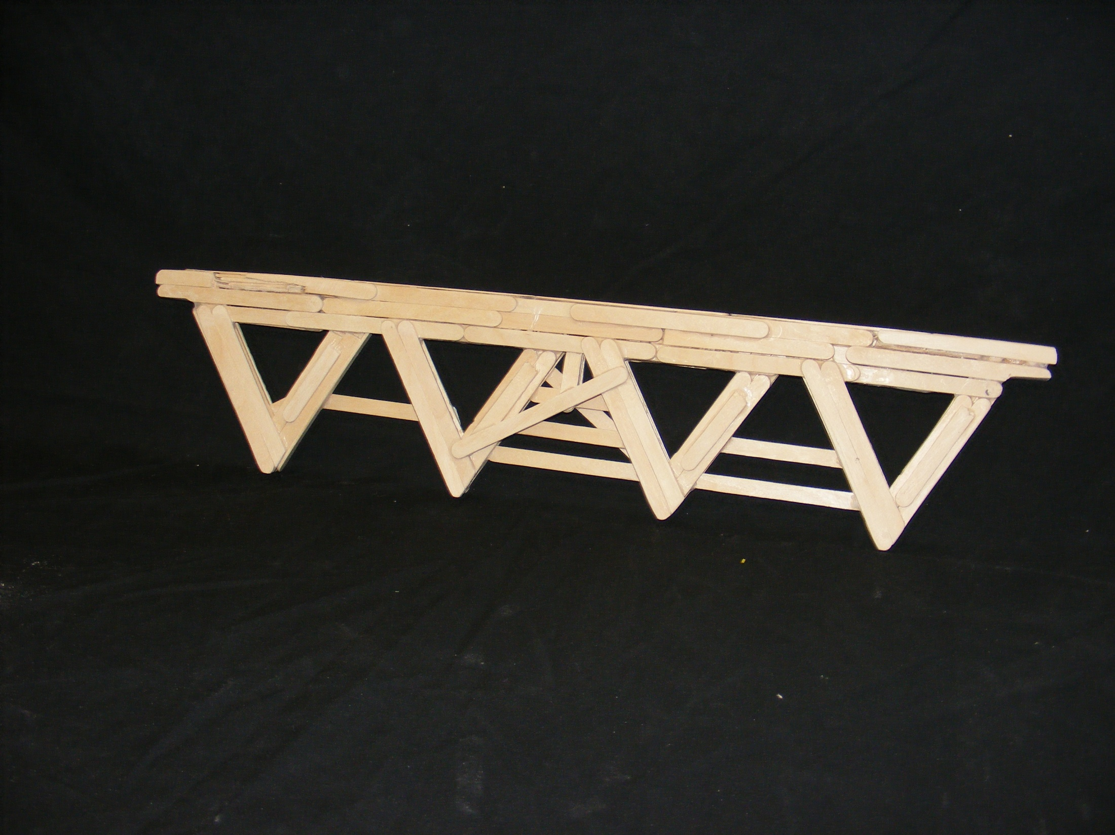
The 23rd Annual
Popsicle Stick Bridge Competition
Milad Sharaf
Bishop Ryan
Best True Truss
Bridge Weight = 221.9g
Performance Rating = 309.9 lb/lb

Slide 9
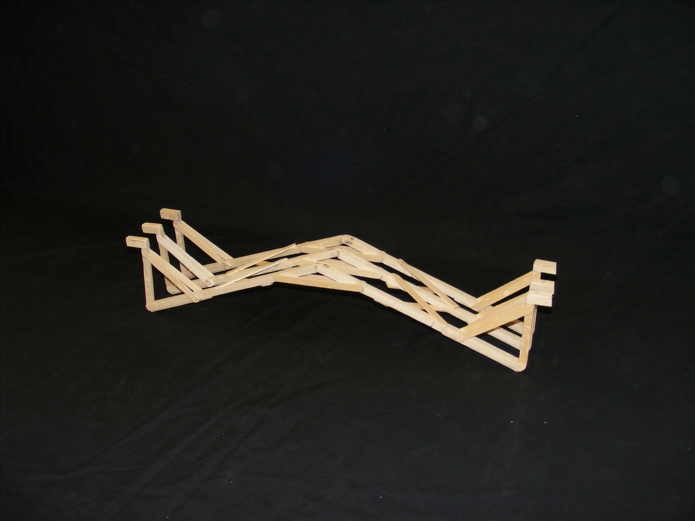
The 23rd Annual
Popsicle Stick Bridge Competition
Alex Everingham, Stephanie Houghton
and Brad Patterson
Highland Secondary
Best Junior Aesthetics
Bridge Weight = 165.0g
Performance Rating = 762.8 lb/lb

Slide 10
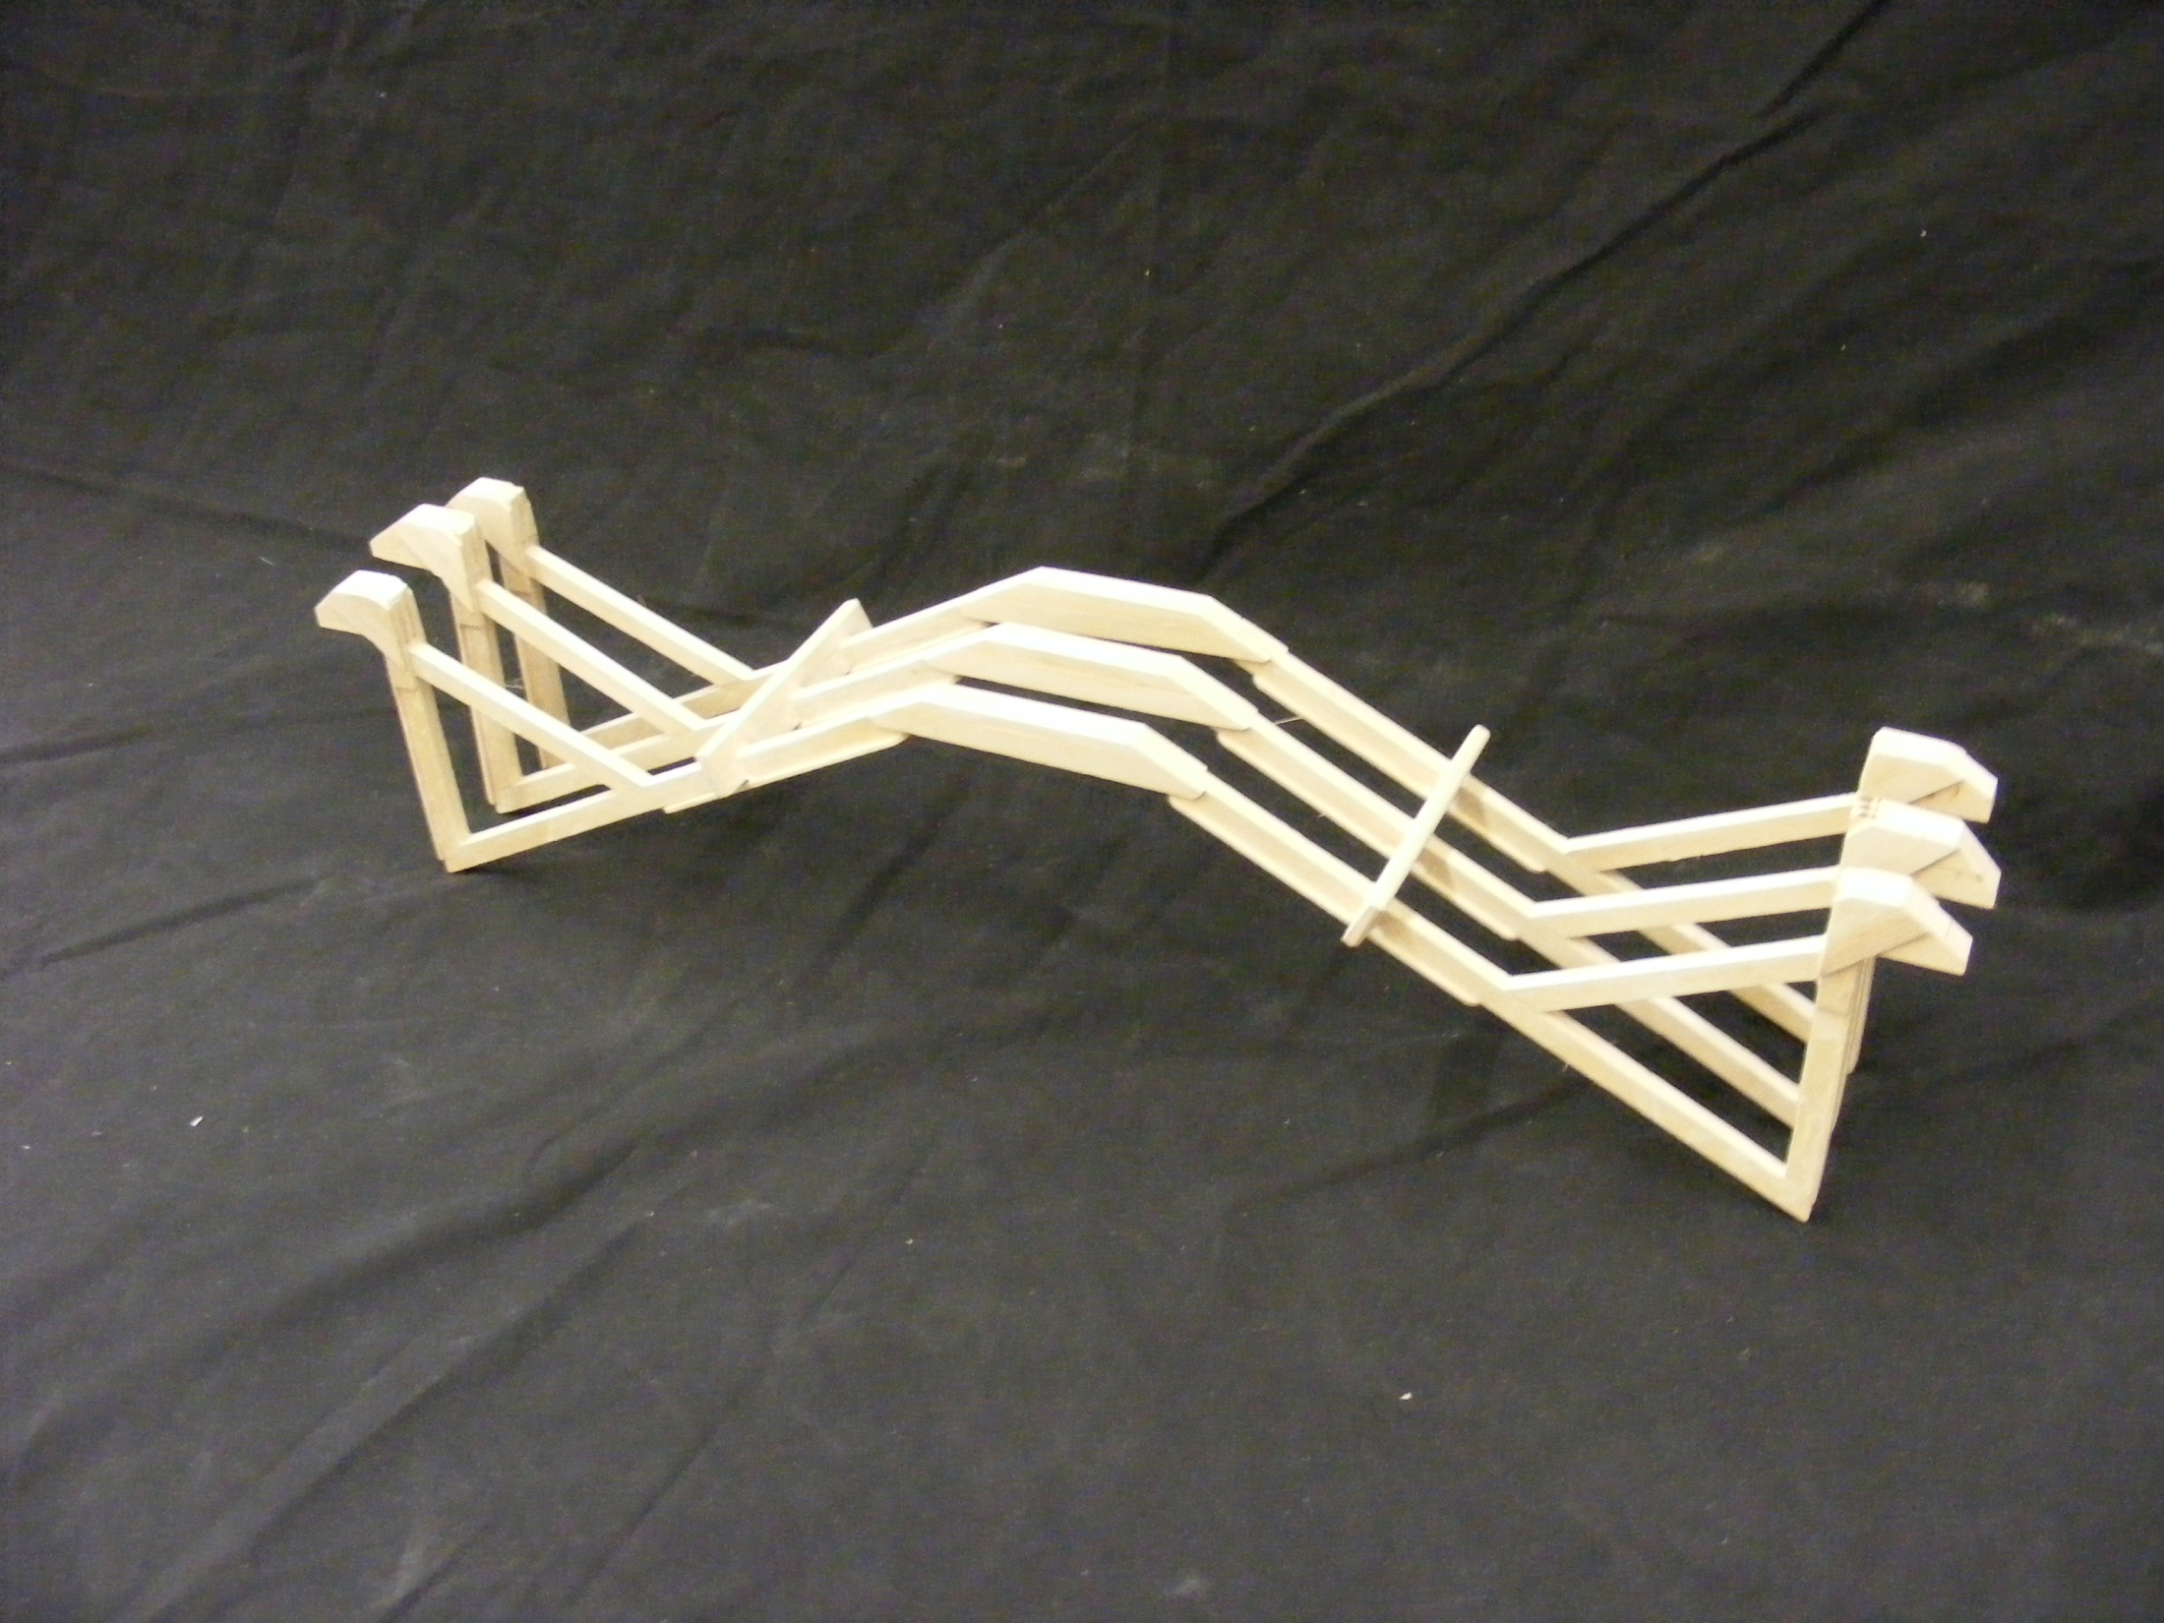
The 23rd Annual
Popsicle Stick Bridge Competition
Alex Liu and David Choi
Westmount Secondary
Best Senior Aesthetics
Bridge Weight = 184.3g
Performance Rating = 999.4 lb/lb

Slide 11
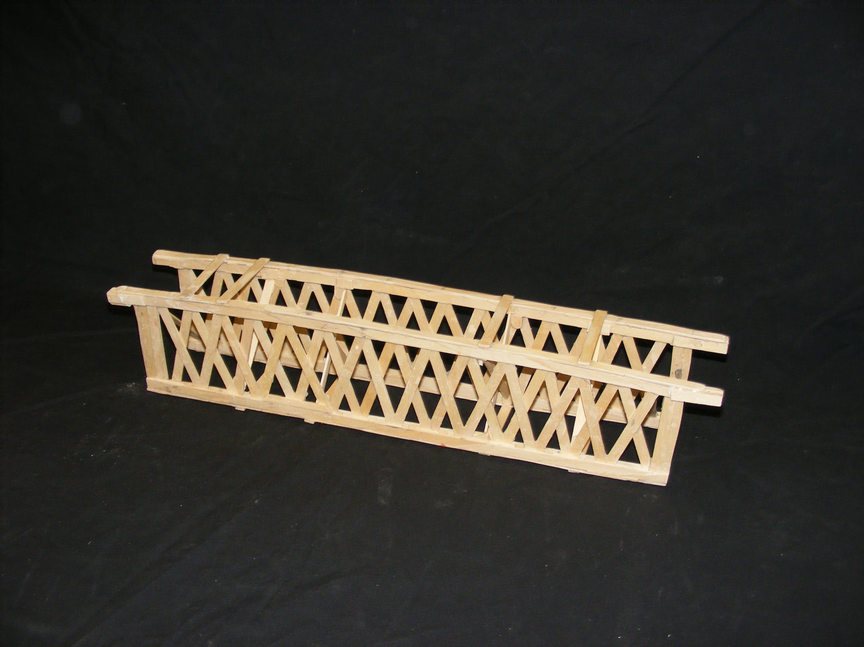
The 23rd Annual
Popsicle Stick Bridge Competition
Bradley Waddell
Westmount Secondary
Most Unique Design
Bridge Weight = 239.9g
Performance Rating = 273.8 lb/lb

Slide 12








The 23rd Annual
Popsicle Stick Bridge Competition
A Special Thanks to all of our Sponsors

